Slide 1
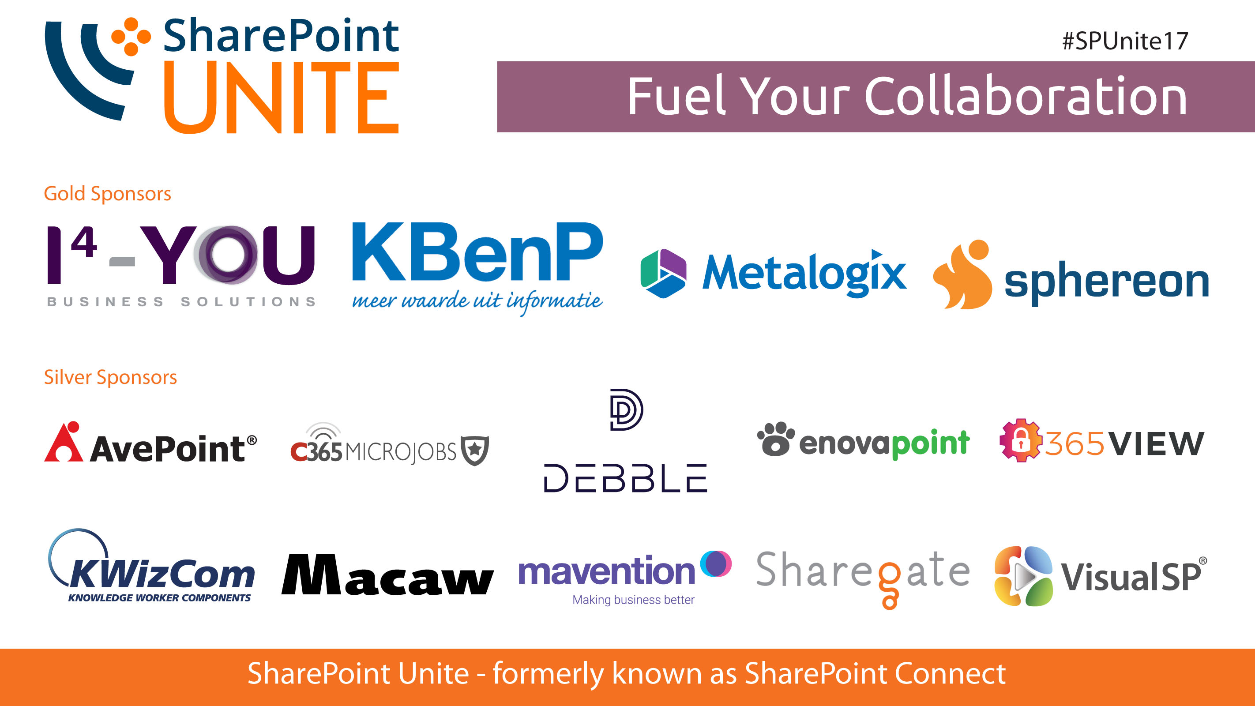

Slide 2

Migrating your customizations from On-Prem to SharePoint Online
Kevin Timmerman – October 26th 2017

Slide 3


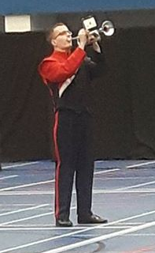






Meet the speaker
Kevin Timmerman
  Working at Avanade Netherlands since 2008
  Manager in the Software Engineering community
Involved in multiple (large) projects implementing and migrating SharePoint
2007, 2010, 2013 and Office 365 / SharePoint Online
Combined roles as developer/team lead & architect/PM
Hobbies
Musician, playing trumpet since 1994
‘Do it your self’ home improvements
Inline skating
@timmermankevin www.timmerman.it timmermankevin kevin.timmerman@avanade.com

Slide 4



Agenda
SharePoint development introduction
Full Trust Code migration challenges
Connected Application migration challenges
Content migration challenges
Other migration observations
Summary
Questions
SharePoint On-Prem
SharePoint Online
Migration Approach

Slide 5
SharePoint Development Introduction

Slide 6
SharePoint Development Introduction
 | SP 2007 | SP 2010 | SP 2013 | SP 2016 | O365/SPO
Full Trust Code Solutions | YES | YES | YES | YES | NO
ASMX web services | YES | YES | YES | YES** | YES**
Sandbox solutions | NO | YES | YES* | YES* | YES*
CSOM/REST API’s | NO | YES | YES | YES | YES
Add-ins | NO | NO | YES | YES | YES
SharePoint Framework | NO | NO | NO | NO*** | YES
* Only declarative sandbox solutions are supported. Code solutions are deprecated and are unavailable on O365/SPO
** Still available, but the recommendation to switch to CSOM/REST API’s which might indicate that the ASMX services will be deprecated in the near future
*** The SharePoint Framework is added to the Feature Pack 2 released in Fall 2017

Slide 7
Full Trust Code migration challenges

Slide 8
Full Trust Code migration approach
Readiness
Solution Assessment
Solution Planning
Development & Testing
Deployment
Obtain proper understanding on the app model
Hosting decisions
Solution package assessment one by one
Can be partly automated with existing tooling
Analyze requirements
Initial high level planning based on functional and business requirements
Detailed technical planning
Actual development and testing based on previous steps
Deployment of apps
Transforming content
Retracting solutions

Slide 9

What do you really want to achieve?

Slide 10
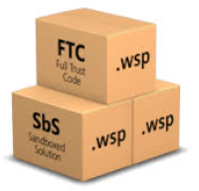
Typical Full Trust Code functionality
Activate or deactivate features
Permission management
SharePoint Designer settings
Site logo
Audit settings
Regional settings
Time zone settings
Site branding
Language settings
Add artifacts/files to site
Site columns
Content type definitions
List/library definitions
Home page web parts
Event receivers
Subsite creation

Slide 11
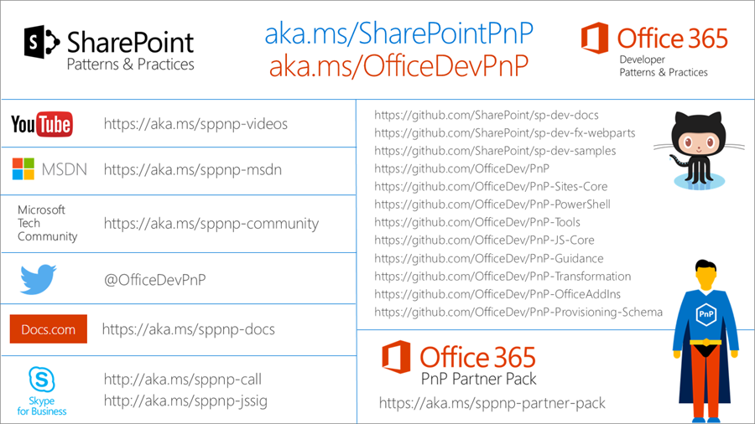
Use SharePoint Patterns & Practices Framework

Slide 12
Identify potential migration challenges

Slide 13

How to identify (FTC) challenges
Custom CSOM/FTC/PowerShell scripts to run against existing farm
Analyze the FTC solutions/WSP’s source code
SMAT Tool (SharePoint Migration Assessment Tool )
  Although called the 2013 migration tool, it also works on 2010 and 2016.
  Download: https://www.microsoft.com/en-us/download/details.aspx?id=53598
  Run directly from command prompt on a WFE using a farm admin
  account:
    SMAT.exe [-o] [-t] [-sv]
Output folder
Skip checks
# threads

Slide 14
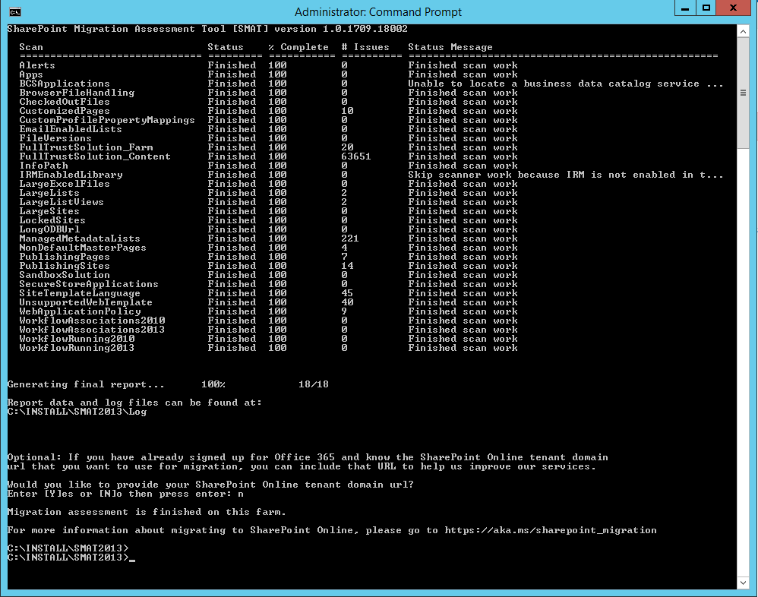
SharePoint Migration Assessment Tool

Slide 15
SharePoint Migration Assessment Tool (2)
Reports on many types of customizations/remediation area’s:
Add-Ins
Alerts
BCS
Browser File Handling
Checked-out Files
Custom Profile Mappings
Customized Pages
Email Enabled Lists
File Versions
Full Trust Code (FTC)
InfoPath
IRM Enabled Lists
Large Excel Files
Large List Views
Large Lists
Large Sites
Locked Sites
Long OneDrive URL’s
Managed Metadata Columns
Master Pages
Publishing Pages
Publishing Sites
Sandbox solutions
Secure Store
Site Template Language
Unsupported Site Templates
Web Application Policies
Workflow Associations
Running Workflows

Slide 16
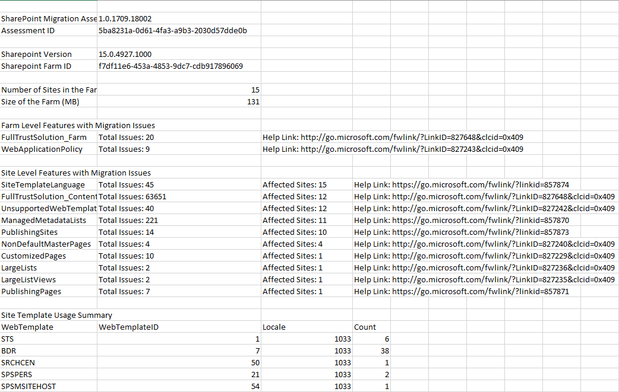
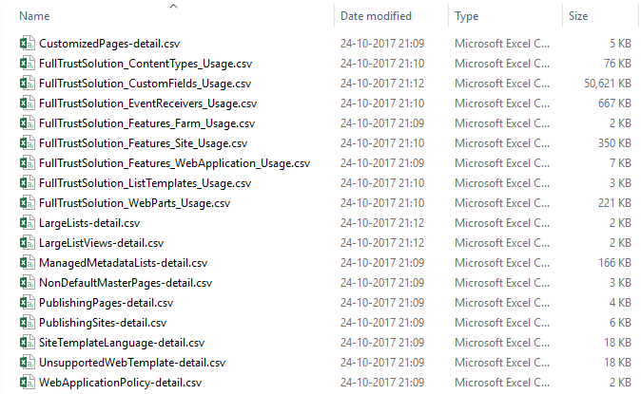
SharePoint Migration Assessment Tool (3)
Example output:

Slide 17
Remediation challenges
In the next slides these most common FTC remediation challenges and solutions will be addressed:
Site branding
Custom Web Controls & Web Parts
Custom User Profile Properties
Timer Jobs
Event receivers

Slide 18
Site branding

Slide 19
Custom master page vs. (O365) theme
Custom master page
  Can introduce any level of customizations
  When new changes are introduced to the OOTB master page, those should be copied to custom master pages as well
    Additional maintenance burden
  Future major version upgrades can cause additional requirements to re-create the end user experience

Slide 20
Custom master page vs. (O365) theme (2)
O365 theme
  Centrally control branding across all services in O365
  Overriding the O365 theme can be enabled/disabled by tenant admin
  No customizations required, so no additional costs during future upgrades
  Not available on-prem
Site theme
  Can be introduce to bring color, font and background image settings
  Sites with themes will still use OOTB master pages, so any updates will be automatically reflected on the sites
  Future major version upgrades don’t cause additional costs
  Needs to be stored on each site collection
    Additional maintenance burden
Alternate CSS
  Simple styling using CSS
  Won’t break in case of SharePoint upgrades
  Store on central location accessible to everyone
  Not yet applied to the modern UI

Slide 21
Remediation strategy
1
Identify custom master pages and alternate CSS used
2
Create CSOM/PowerShell script to implement new branding strategy (revert to OOTB Master Page/unghost Master Page/CSS file/use themes)
3
Create new sites with new branding strategy
Remove FTC branding solution (including any non-referenced FTC Master Pages etc)
During implementation the FTC and new approach will co-exist, allowing a phased roll-out and pilot testing
If issues occur, you can easily switch back to the FTC solution and determine a new approach/solution

Slide 22
Custom Web Controls & Web Parts

Slide 23
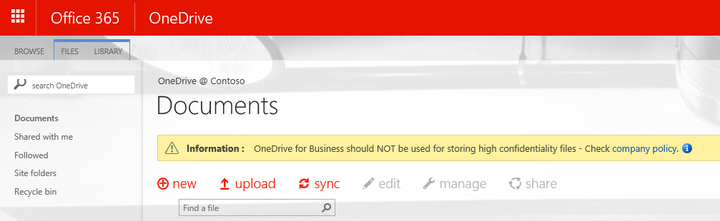
Custom Web Controls & Web Parts
Rather than implementing custom web controls/web parts, use standard content/script editor web parts in combination with JavaScript injection
Full Trust Code
  Custom web control on master page
  Will break if FTC is removed
  Downtime for each upgrade/change
  Association of JavaScript injection (user custom action) to the site, so that code is executed during site processing.
SharePoint
Service
1
Provider Hosted Add-in
CSOM / REST
2
JavaScript Injection approach
  Client-side rendering using JavaScript
  Use the JSOM and REST API’s in SharePoint (on-prem and SPO)
  No downtime for upgrades/changes
<<Reference>>
js
3
  UX elements are rendered with JavaScript by using a script stored either in SharePoint, centrally in the provider hosted Add-in or in some CDN. Preferable in one location for easy update cross all instances.

Slide 24
Remediation strategy
1
Identify custom web controls and web parts used
2
Create CSOM/PowerShell script to add the Custom Action to the affected sites
3
Create new sites with new custom action/OOTB web parts being added
Remove FTC custom web control/web part solution
4
Create script to replace any web parts with script editor/content editor web part
Create script to remove the custom web controls

Slide 25
Custom User Profile Properties

Slide 26
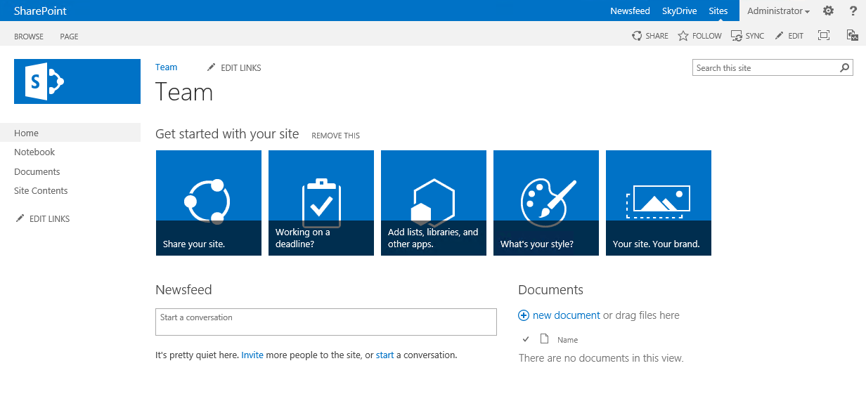
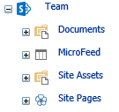
Custom User Profile Properties – on-prem
Most common on-prem situation:
- Additional user profile properties can be mapped in the SharePoint User Profile Service and can be directly read/written to/from AD
SharePoint
Service
2
1
Active Directory
  Functionalities can use the user profile properties to show information or to change the end user experience.
3

Slide 27
Custom User Profile Properties - SPO
A standardized set of attributes are replicated from Azure Active Directory to the SharePoint Online User Profile Store within Office 365. Unlike on-premises SharePoint, these attributes cannot be customized.
Customer
SharePoint
Service
Active Directory
2
Azure
Active Directory
1
5
3
Custom
synchronization
tool
  Standardized set of attributes are replicated to the SharePoint user profile store.
json
  Functionalities can use the user profile properties to show information or to change the end user experience.
6
4
  JSON file for bulk updates in the user profile store
LoB Systems
  Custom synchronization tool for extended attributes what needs to be synced to SharePoint user profile
Notes:
https://msdn.microsoft.com/en-us/pnp_articles/bulk-user-profile-update-api-for-sharepoint-online

Slide 28
Remediation strategy
1
Identify and create User Profile Properties on SharePoint Online based on existing apps/requirements
2
Create and periodically schedule custom synchronization tool to perform the bulk updates
3
Adjust any SharePoint customizations which use user properties where needed
On-premise SharePoint does not support updating User Profile properties via CSOM. Here you need to use the standard profile mapping from the UPS or a customization

Slide 29
Timer Jobs

Slide 30
Timer Jobs
Full trust code timer jobs are not available on O365, these need to be replaced with remote timer jobs which can be hosted anywhere (including Azure webjobs)
  Scheduled execution which accesses the needed resources from the SharePoint service and performs the required automation.
  Can use either specific account for connection or oAuth based app-only token approach
Full Trust Code Timer Job
  Runs as part of SharePoint
  Execution controlled by SharePoint
  Downtime for each upgrade/change
SharePoint
Service
Remote Timer Job
  Use CSOM/REST API’s
  Runs outside SharePoint
  More flexible execution control
  No downtime for upgrades/changes
2
Provider Hosted Apps
1
Remote timer job

Slide 31
Remediation strategy
1
Identify location for the remote timer job to run (Azure web job, on-prem server executable with scheduled task etc)
2
Recreate the FTC functionality using the CSOM/REST API’s
3
Activate/schedule the remote timer job and retract the FTC timer job solution
If the timer job needs to connect to on-prem resources as well, it might be easier to host it inside the company’s network to prevent challenges with incoming traffic firewall rules

Slide 32
Event Receivers

Slide 33
Event Receivers
LOB
System
Event receivers can’t be used anymore in SharePoint Online and need to be replaced by remote event receivers which will hosted externally
4
Full Trust Code Event Receiver
  Runs as part of SharePoint
  Guaranteed execution
Provider Hosted Apps
Users
1
3
Remote Event Receiver
  External web service is called when events in host web occur
  No guaranteed execution
  Hosting in Azure is preferred
SharePoint
Service
5
Access Control
System
2

Slide 34
Remediation strategy
1
Identify location for the remote event receiver (Add-In, external web service etc)
2
Recreate the FTC functionality in the web service using the CSOM/REST API’s
3
Retract the FTC event receiver solution WSP
4
Replace the FTC event receiver registration with the remote event receiver in the SharePoint site/list/list item
Be aware that there is no guaranteed delivery for remote event receivers, e.g. due to network errors
A workflow might be a better solution in some use cases

Slide 35
Connected Application migration challenges

Slide 36
What is a Connected Application
An application which is located outside SharePoint and performs operations against SharePoint
  Provider hosted application
  Windows applications
  Console applications
Can be identified from a combination of sources:
  Application registries maintained by your organization
  Consulting with existing application support teams
  Analyzing the SharePoint on-prem IIS logs:
    Accounts known to be used for applications (e.g. service accounts)
    Calls to REST API’s and ASMX web services

Slide 37
(Connected) Application considerations
Maintenance and operational costs
Long term roadmap of your customization vs. SharePoint roadmap
Ability to create additional functionality
Flexible model to serve both on-premise and O365/SPO
No SharePoint downtime anymore during deployments
Keep as close as possible to out of the box functionality

Slide 38
Connected Applications
Applications connecting into SharePoint 2013 or 2016 need to update their authentication mechanism to work against SharePoint Online:
  Current user account (e.g. first.lastname@contoso.com)
  Cloud Identity (e.g. first.lastname@contoso.onmicrosoft.com)
  Token and Client Secret
  Azure AD Token and certificate
Use the ADAL library to do most of the work for you in your app
Bear in mind that the authentication/token will expire after 1 hour, and as per best practice it’s recommended to cache the token for ~50 minutes if your connected application performs a lot of requests

Slide 39
Handling throttling and network outages
If a ExecuteQuery is throttled by SharePoint, it throws a HTTP status code 429: “Too many requests”
You can catch this error code and implement a cool down and retry mechanism
The Core.Throttling example from the PnP framework has the “ExecuteQueryWithIncrementalRetry” extension method to catch HTTP codes 429 and 503
If you also want to catch any other unexpected errors (like timeouts/network outages), you can implement the same approach
More information about connecting to SPO and best coding practices can be found in my presentation from last year: http://www.timmerman.it/index.php/session-slides-and-code-effective-client-side-coding-against-o365/

Slide 40
Content migration challenges

Slide 41
Remediation challenges
In the next slides these content remediation challenges and solutions will be addressed:
Custom Field Types, Site Definitions and List Definitions
Sandbox solutions
List Templates
Large Lists
Large List Views
Running Workflows
Workflow Definitions
InfoPath Forms

Slide 42
Custom Field Types, Site Definitions and List Definitions

Slide 43
Custom Field Types, Site Definitions and List Definitions
Unfortunately, there are not replacement options in SharePoint Online for these customizations and the only option is a content migration
1
Identify the locations where these customizations are used
2
Recreate the content structure using OOTB functionality
3
Migrate the content from the old location to the new location

Slide 44
Sandbox Solutions

Slide 45

Sandbox Solutions
Code based sandbox solutions are already deprecated for a while, but people might still be using these on on-premise farms.
Only declarative sandbox solutions are still allowed, at this moment…
Sandbox solutions normally aren’t migrated by migration tooling, but if they are, on SharePoint Online any code-based sandbox solution can’t be activated anymore.
If not properly remediated prior to the migration, this might lead to
orphaned FTC references and issues after the migration
E.g. if a List Definition doesn’t exist anymore, the list will break and will
cause CSOM calls to retrieve all Lists on the site to fail.

Slide 46
Remediation strategy
1
Assess the sandbox solution WSP’s
2
Ensure any solution files are unghosted and copied into the actual site (content DB)
3
Deactivate sandbox features and remove sandbox solution
4
Update sandbox solution to not remove files upon FeatureDeactivating event
Remove any FTC references added by the sandbox solution (e.g. event receivers)

Slide 47
List Templates

Slide 48
List Templates
List Templates can contain references to Full Trust Code (e.g. event receivers, custom column definitions).
Those need to be remediated prior, or as part of the migration to SharePoint Online.
Approach 1
Remediate all FTC references from existing lists/libraries
Backup and delete all existing List Templates and inform end user to recreate the templates
Approach 2
Remediate all FTC from existing lists/libraries
Remediate the List Templates by investigating the STP file and update the STP contents to remove the references to FTC

Slide 49
List Templates – Approach 2
Rename the .STP file to .CAB
Extract the .CAB file to a new folder
Open the new folder and locate the “manifest.xml”
Go to the “<Receivers>” node
Locate all “<Receiver>” nodes which relate to your FTC and delete the entire related line from “<Receiver>” to “</Receiver>”
Locate all “<XmlDocument NamespaceURI="http://schemas.microsoft.com/sharepoint/events">” nodes and delete them from “<XmlDocument” until “</XmlDocument>”
Save the “manifest.xml”
Repackage the .CAB file
Rename to .STP an replace the STP in SharePoint

Slide 50
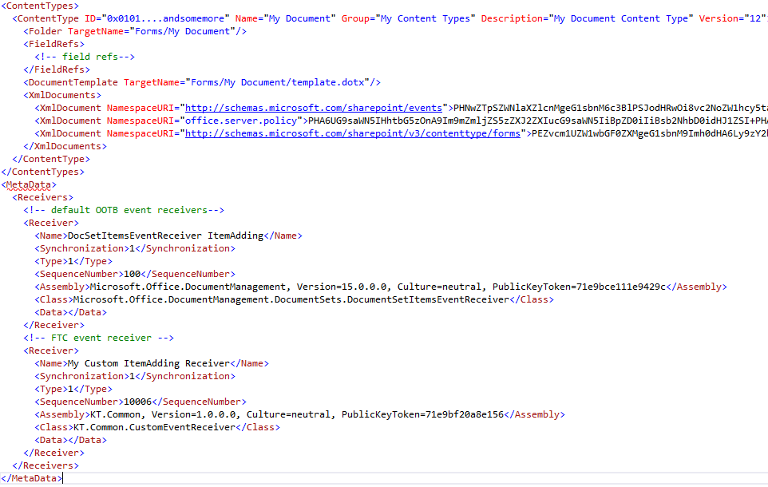
List Templates – Approach 2 example

Slide 51
Large Lists

Slide 52
Large Lists
Large lists (with more than 5.000 items) have been a challenge since SharePoint 2010, but the List View Threshold could easily be increased by a farm admin or a window for this could be configured (aka ‘happy hour’).
On SharePoint Online, these workarounds are not available anymore on any list with more than 5.000 items, if:
More than 5.000 items are returned
More than 5.000 items need to be analyzed if they match the list view conditions
To reduce risk, it’s recommended to review all the lists with more 5.000 items to ensure they can still be accessed on SharePoint Online.

Slide 53
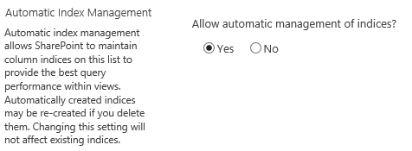
Remediation Strategy
Use folders or additional lists to not have more than 5.000 items in a list/folder
  Requires a content migration, potential breaking links
Configure indexes on the list based on the views already present or create views to split up content
  Requires analysis of the lists, small impact of storage used for the indexes
Note:
There is a maximum of 20 indexes per list
There is still an upper maximum of 20.000 list view threshold, after which indexes can’t be added anymore
SharePoint Online and SP2016 automatically adds indexes when your list approaches the 5000 item limit. Ensure this list/library setting is enabled:

Slide 54
Large List Views

Slide 55
Large List Views
Large list views (with more than 12 lookup columns) have been a challenge since SharePoint 2010, but the List View Lookup Threshold could easily be increased by a farm admin or a window for this could be configured (aka ‘happy hour’).
On SharePoint Online, these workarounds are not available anymore on any list view with more than 12 lookup columns:
Managed Metadata columns
User/People columns
Last Modified By/Created By
Lookup columns
Workflow Status
Name (linked to document/with edit menu), Link (to edit item)
Type (the document icon)

Slide 56
Remediation Strategy
Remove lookup columns from a view if they don’t bring additional value for that view
Split up views which have more than 12 lookup columns
Note:
This is a limitation of the number of lookup columns you can use in a single view, not a limitation of the lookup columns in your list

Slide 57
Running Workflows

Slide 58
Running Workflows
None of the migration tools, to date, is able to migrate workflows which are in progress.
The workflow definitions will be migrated, but the user needs to restart the workflow on SharePoint Online post migration.
The best approach is to inform end users to finish as much as possible running workflows prior to the migration.

Slide 59
Workflow Definitions

Slide 60
Workflow Definitions
Workflow definitions might contain references to user accounts, e.g: MYDOMAIN\John.Doe on SharePoint Online, this account will be i:0#.f|membership|john.doe@mydomain.com.
The workflow definitions need to be updated with these new accounts and then republished.
Note:
The ‘SaveDefinition’ method might fail on large workflows. The alternate solution would be to update the XAML file directly in the “<(sub)site url>/wfsvc/<definition guid without dashes>/<Definition.FullName>” location
Workflow 2010 | Workflow 2013
Located in <(sub)site url>/Workflows/<workflowname>/ | Use ‘WorkflowServicesManager’ to iterate through 2013 workflow XAML definitions
Look for <workflowname>.XOML and .XOML.RULES file | Replace account names
Replace account names | Call ‘SaveDefinition’
Manually republish workflow from SharePoint Designer | Call ‘PublishDefinition’

Slide 61
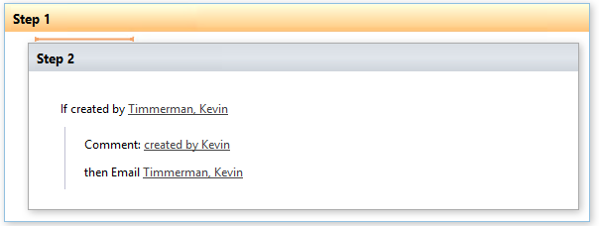
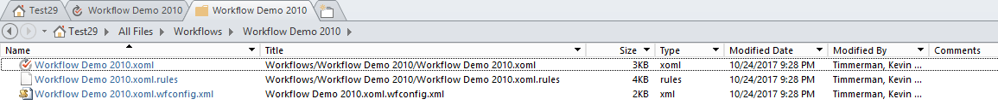
Workflow examples
Generates .rules file

Slide 62
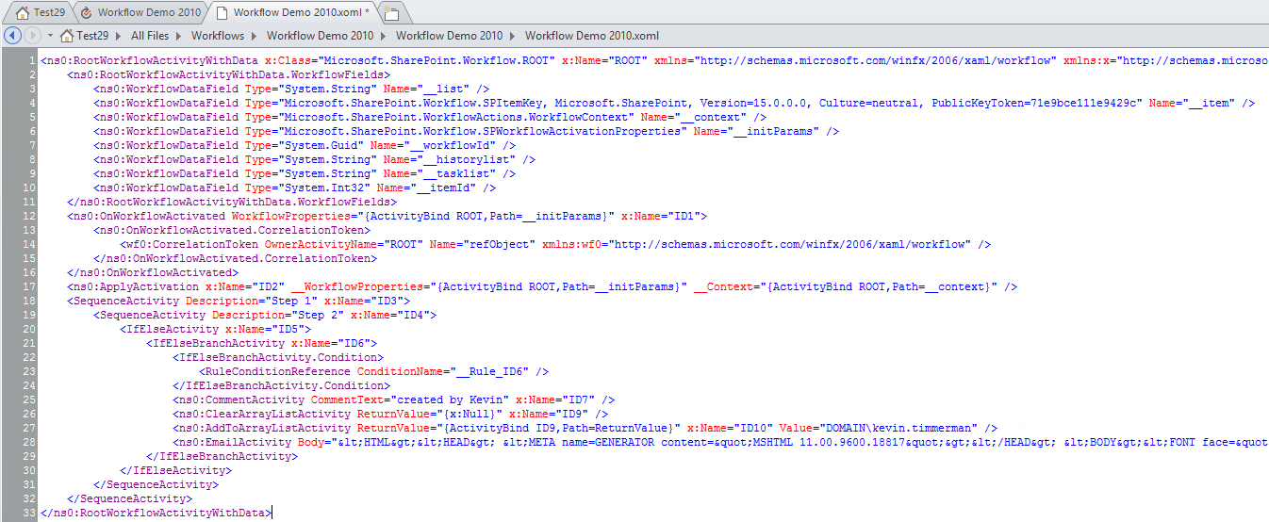
Workflow Definitions (2)

Slide 63
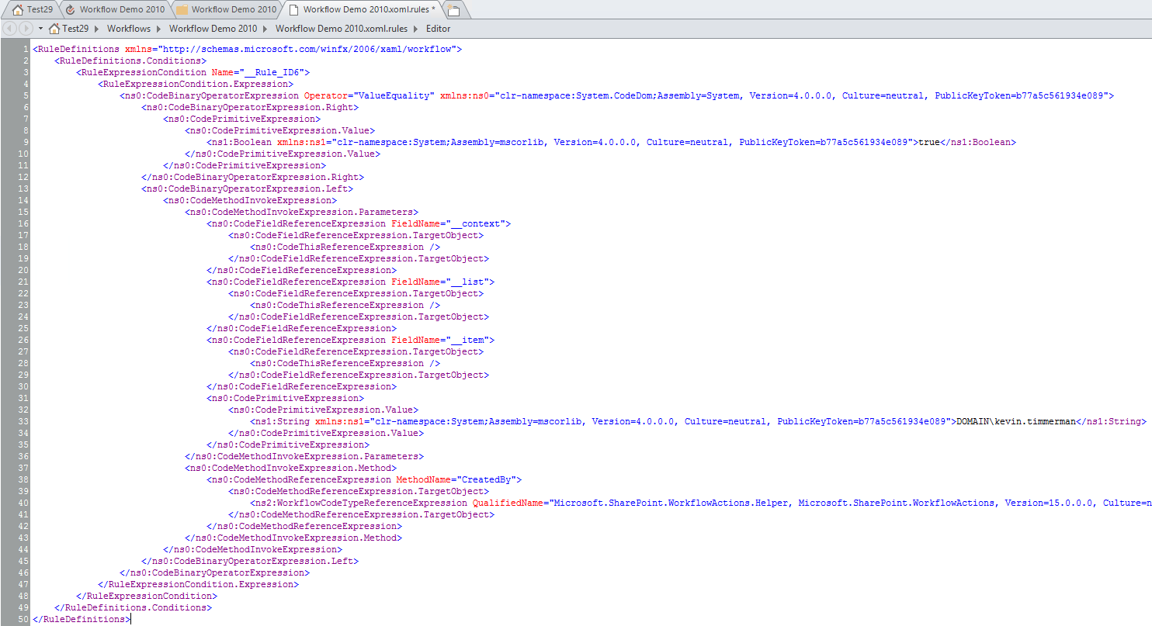
Workflow Definitions (3)

Slide 64
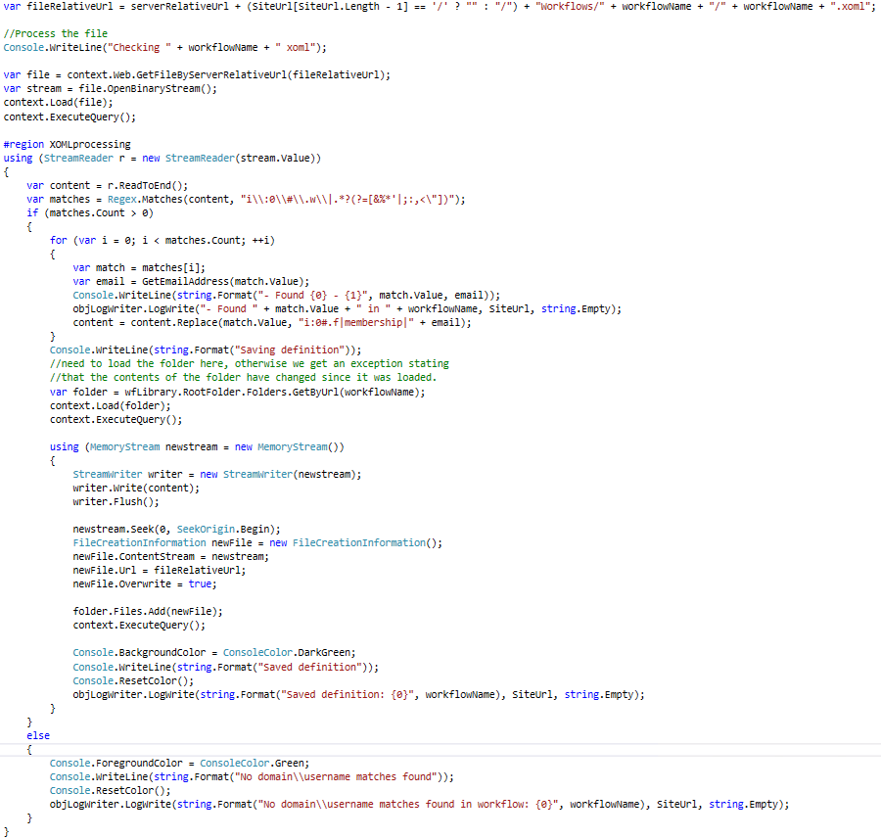
Workflow Definitions (4)

Slide 65
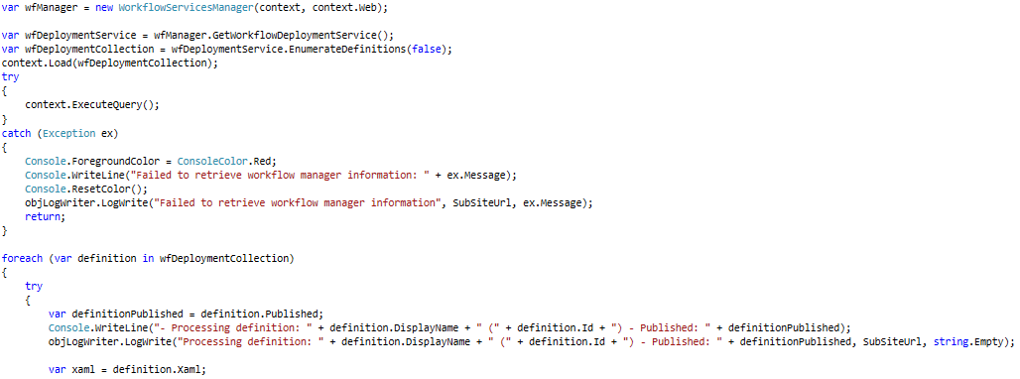
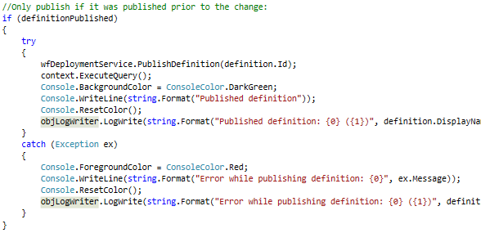
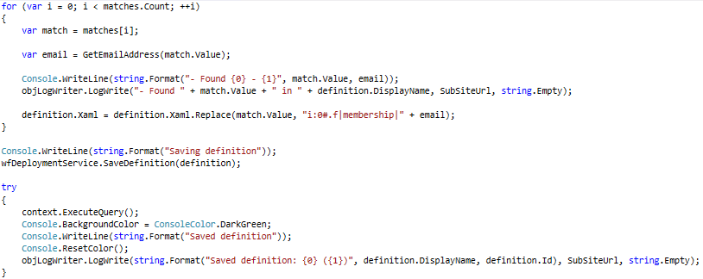
Workflow Definitions (5)

Slide 66
Other Workflow Observations
Other area in workflows which requires attention are:
Impersonation steps: if a 2010 workflow uses impersonation, the user publishing the workflow should continue to have the access which the workflow requires
Sending e-mail: this will only work if the recipient has a SharePoint license assigned
  “The selected user(s) may not be valid on the site this workflow is published on. If a recipient is not a valid SharePoint user, he or she will not receive workflow emails”
Workflows don’t trigger if the creator if the item is: ACS Token, System Account or a workflow. If the item is created by another workflow, impersonation or app-step needs to be used to create the item under a user’s context.

Slide 67
InfoPath Forms

Slide 68

InfoPath Forms
InfoPath forms might contain references to user accounts, e.g: MYDOMAIN\John.Doe on SharePoint Online, this account will be i:0#.f|membership|john.doe@mydomain.com.
The InfoPath form needs to be updated with these new accounts and then republished.
PnP framework has a tool to do this for you: https://github.com/SharePoint/PnP-Transformation/tree/dev/InfoPath/Migration/PeoplePickerRemediation.Console
If InfoPath forms already exist for a while (e.g. created in SharePoint 2003/2007), for fields to be populated based on SharePoint data, the entire list was received and than filtered in the InfoPath form.
On SharePoint Online, this might lead to the “The form could not be displayed because default values or rules are taking too long to evaluate” error. To resolve this, ensure the ‘queryfields’ is used to already filter the data from the SharePoint list (instead of inside the InfoPath form).

Slide 69
InfoPath Forms (2)
Microsoft is not improving InfoPath anymore and support will continue until April 2023, so what will be the best replacement of InfoPath?
O365 Forms?
O365 PowerApps?
HTML5 forms?
SharePoint Lists (Modern UI)?
Third Party products?

Slide 70
Other migration observations

Slide 71
Other migration observations
By default on SharePoint Online 500 major versions are kept in a document library, this is different than on-prem (no default)
The contact webpart needs to be remediated as well post migration (from DOMAIN\username to the new user claim format)
The access request e-mails need to be remediated as well post migration (from DOMAIN\username to the e-mail address)
Calendar overlays between site collections is not supported anymore
Audit reports are now split per 10K rows per Excel file

Slide 72
Summary

Slide 73

Summary
Be informed about the Full Trust Code components running in your farm
Run the SMAT Tool to assist you with identifying remediation area’s
Remediate as much as possible prior to the migration
  PnP has tools to assist with this: https://github.com/SharePoint/PnP-Transformation
Have a support team available to remediate/assist end users quickly with items which can’t be remediated in advance
Inform users about area’s on their site which require their attention and keep them informed throughout the migration journey.

Slide 74
Questions?

Slide 75
Thanks for attending!
@timmermankevin www.timmerman.it timmermankevin kevin.timmerman@avanade.com

