Slide 2
Effective Client-side Coding against Office 365
Kevin Timmerman
November 17th 2016

Slide 3
Meet the speaker
Kevin Timmerman
Sr. Consultant at Avanade since 2008
Software Engineering – SharePoint community
Involved in multiple (large) projects implementing SharePoint 2007, 2010, 2013 and Office 365 / SharePoint Online
Combined roles as developer/team lead and architect/PM
Hobbies
Musician, playing trumpet since 1994
‘Do it your self’ home improvements
Started with inline skating again
@timmermankevin www.timmerman.it timmermankevin kevin.timmerman@avanade.com

Slide 4
Agenda
SharePoint development introduction
The PnP Framework
Authentication methods
Efficient querying via SharePoint API’s
Handling throttling and network outages
How to include this in the SharePoint Framework
And of course code demo’s ☺

Slide 5
SharePoint development introduction
 | SP 2007 | SP 2010 | SP 2013 | SP 2016 | O365/SPO
Full Trust Code Solutions | YES | YES | YES | YES | NO
ASMX web services | YES | YES | YES | YES** | YES**
Sandbox solutions | NO | YES | YES* | YES* | YES*
CSOM/REST API’s | NO | YES | YES | YES | YES
Add-ins | NO | NO | YES | YES | YES
SharePoint Framework | NO | NO | NO | NO | YES
* Only declarative sandbox solutions are supported. Code solutions are deprecated (and will be turned off on O365/SPO)
** Still available, but the recommendation to switch to CSOM/REST API’s which might indicate that the ASMX services will be deprecated in the near future

Slide 6
The PnP Framework

Slide 7
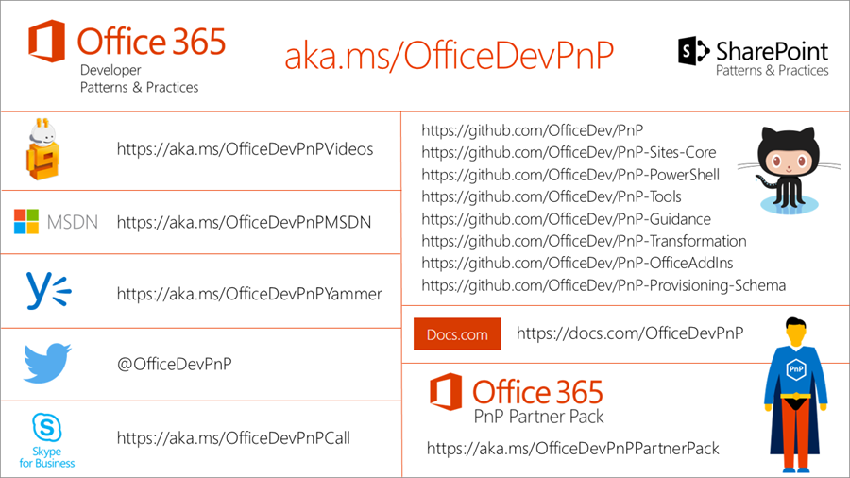
The PnP Framework

Slide 8
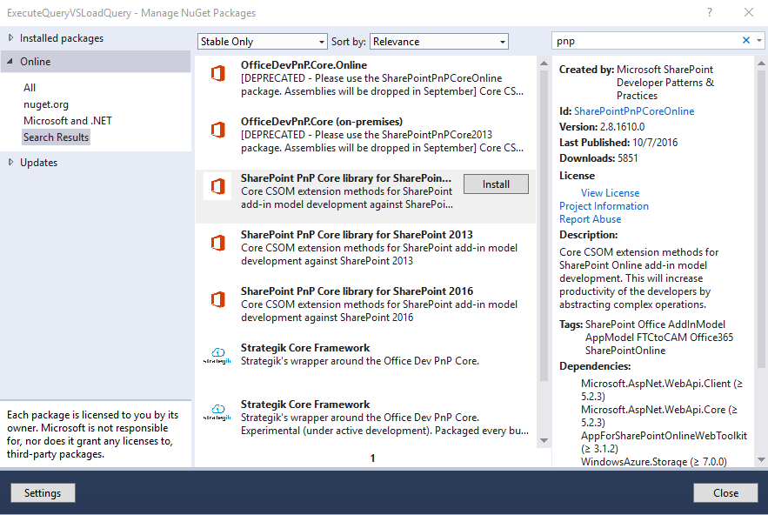
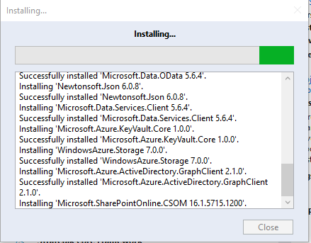
Demo
How to use the PnP Framework

Slide 9
Authentication Methods

Slide 10
Authentication Methods
There are several methods to authenticate for apps/add-ins
Current user account (e.g. first.lastname@contoso.com)
Cloud Identity (e.g. first.lastname@contoso.onmicrosoft.com)
Token and Client Secret
Azure AD Token and certificate
Use the ADAL library to do most of the work for you in your app
Bear in mind that the authentication/token will expire after 1 hour

Slide 11
Demo
Authentication methods

Slide 12
Efficient querying via SharePoint API’s

Slide 13
Efficient querying via SharePoint API’s
Only request the properties you need in Load/LoadQuery methods
Limits required bandwidth
Limits memory consumption
Only retrieve the objects and properties you need
LoadQuery method
Let SharePoint do the processing
On very large sites (e.g. with thousands of lists), if you retrieve all properties, this can easily lead to time-outs.

Slide 14
Efficient querying via SharePoint API’s
Performance difference Load vs. LoadQuery when retrieving SCA’s
1000 users are present on the demo site
Based on 100 requests, the time required to perform a LoadQuery is ~33% more efficient
The response body from SharePoint is only 500 bytes vs 10 KB
Performance difference Load vs. LoadQuery when retrieving hidden lists
30 lists/libraries are present on the demo site
Based on 100 requests, the time required to perform a LoadQuery is ~2% more efficient
The response body from SharePoint is only 1KB vs 2KB

Slide 15
Efficient querying via SharePoint API’s
Use batching to perform large operations
Resolving 1000 users in one batch results in a timeout after the default 90 seconds timeout
Using a batch size of 100 users, there are 10 requests required and all calls succeed in a total of ~2 minutes
Same approach can be used for batch updates to list items, read operations or other large operations you might want to perform against SharePoint

Slide 16
Efficient querying via SharePoint API’s
When using a token to authenticate:
Cache your tenant’s realm/token for multiple requests
A token is valid for one hour, so you only need to refresh/re-request it again after one hour
If you request it for every ExecuteQuery, this delays the request and consumes additional SPO resources and bandwidth
Be aware that in SharePoint Online, if a site does not exist it throws a forbidden error when trying to request a token or performing an ExecuteQuery
To avoid this, it’s best to first perform a WebClient request as this will properly respond with a “404 Not Found” code if the site does not exist

Slide 17
Demo
Efficient querying

Slide 18
Handling throttling and network outages

Slide 19
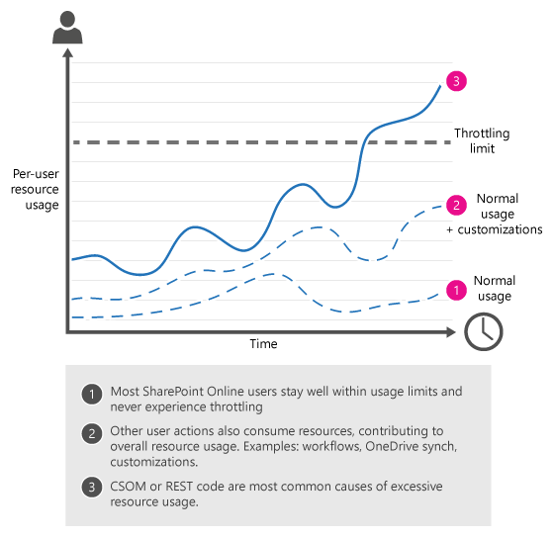
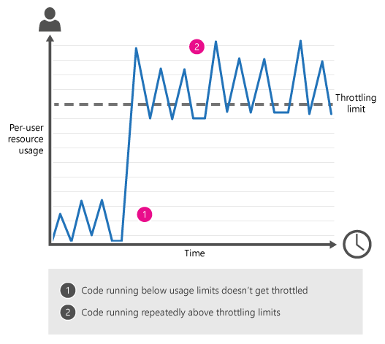
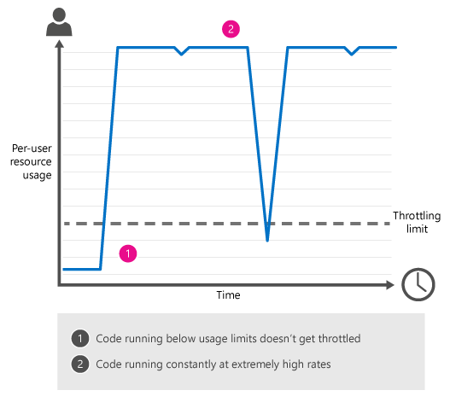
Handling throttling and network outages
SharePoint Online uses throttling to maintain optimal performance and reliability of the SharePoint Online service. Throttling limits the number of user actions or concurrent calls (by script or code) to prevent overuse of resources
throttling design sporadic traffic overwhelming traffic

Slide 20
Handling throttling and network outages
If a ExecuteQuery is throttled by SharePoint, it throws a HTTP status code 429: “Too many requests”
You can catch this error code and implement a cool down and retry mechanism
The Core.Throttling example from the PnP framework has the “ExecuteQueryWithIncrementalRetry” extension method to catch HTTP codes 429 and 503
If you also want to catch any other unexpected errors (like timeouts/network outages), you can implement the same approach

Slide 21
Demo
Throttling and network outages

Slide 22
How to include this in the SharePoint Framework

Slide 23
How to include this in the SharePoint Framework
The SharePoint Framework primarily uses JSOM
The code examples were in CSOM, but the same approaches can be rewritten and reused in JSOM

Slide 24
Summary

Slide 25
Summary
Use the PnP Framework for authentication and best practices
Only retrieve the objects you need from SharePoint
Be aware of throttling limits and potential time-outs

Slide 26
Questions?

Slide 27
Thanks
And enjoy the remaining sessions at UnityConnect!
@timmermankevin www.timmerman.it timmermankevin kevin.timmerman@avanade.com

